Slide 1









Whiteboardmaths.com
7
2
1
5
© 2004 All rights reserved

Slide 2
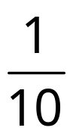
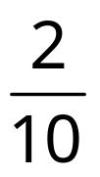
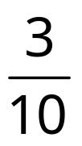
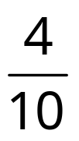

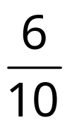
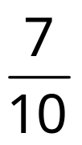
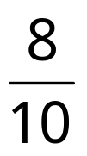
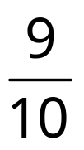

Fractions, Decimals and Percentages
0
1
0
0.1
0.2
0.3
0.4
0.5
0.6
0.7
0.8
0.9
1
0%
10%
20%
30%
40%
50%
60%
70%
80%
90%
100%
Just different ways of saying the same thing.

Slide 3
Fractions, Decimals and Percentages
0
1
0
0.2
0.4
0.6
0.8
1
0%
20%
40%
60%
80%
100%
Just different ways of saying the same thing.

Slide 4
Fractions, Decimals and Percentages
Fraction
0
1
Decimal
0
1
0.3
0.5
0.7
Percentage
0%
100%
10%
30%
60%
80%

Slide 5
Fractions, Decimals and Percentages
Fraction
0
1
Decimal
0
1
0.7
0.3
Percentage
0%
100%
70%
30%

Slide 6
Fractions, Decimals and Percentages
Fraction
0
1
Decimal
0
0.6
1
0.4
Percentage
0%
60%
100%
40%

Slide 7
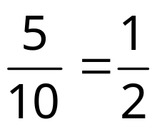
Fractions, Decimals and Percentages
Fraction
0
1
Decimal
0
0.5
0.5
1
Percentage
0%
50%
100%
50%

Slide 8
Fractions, Decimals and Percentages
Fraction
0
1
Decimal
0
0.9
1
0.1
Percentage
0%
90%
100%
10%

Slide 9
Fractions, Decimals and Percentages
Fraction
0
1
Decimal
0
0.6
0.4
1
Percentage
0%
30%
70%
100%

Slide 10
Fractions, Decimals and Percentages
Fraction
0
1
Decimal
0
0.6
1
0.4
Percentage
0%
80%
100%
20%

Slide 11
Fractions, Decimals and Percentages
Fraction
0
1
Decimal
0
0.3
0.7
1
Percentage
0%
100%
40%
60%

Slide 12
Fractions, Decimals and Percentages
Fraction
0
1
Decimal
0
1
0.3
0.7
Percentage
0%
100%
70%
30%

Slide 13





















10 divisions
0
1
100 divisions
0
1
0
0.1
0.2
0.3
0.4
0.5
0.6
0.7
0.8
0.9
1
0.09
0.15
0.20
0.10
0.07
0.04
0.06
0.02
0.05
0.08
0.01
0.03
9%
15%
20%
10%
7%
4%
6%
2%
8%
1%
5%
0
3%
10%
20%
30%
40%
50%
60%
70%
80%
90%
1

Slide 14
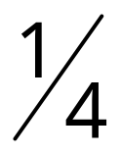
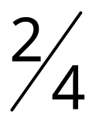
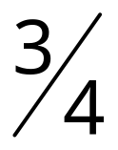
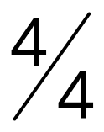
10 divisions
0
1
100 divisions
0
1
0.1
0.2
0.3
0.4
0.5
0.6
0.7
0.8
0.9
0
0.10
0.20
0.30
0.40
0.50
0.60
0.70
0.80
0.90
1
0
0.25
0.75
1

Slide 15
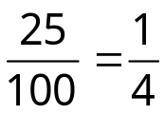
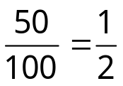
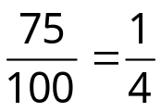
Fractions, Decimals and Percentages
Fraction
0
1
Decimal
0
1
0.25
0.5
0.75
Percentage
0%
100%
25%
50%
75%

Slide 16



Fractions, Decimals and Percentages
Fraction
0
1
Decimal
0
1
0.15
0.35
0.85
Percentage
0%
100%
15%
35%
85%

Slide 17



Fractions, Decimals and Percentages
Fraction
0
1
Decimal
0
1
0.25
0.65
0.8
Percentage
0%
100%
45%
70%
95%

Slide 18
Why is 0.35 smaller than 0.8 ?
100 divisions
0.1
0.2
0.3
0.4
0.5
0.6
0.7
0.8
0.9
0
0.10
0.20
0.30
0.40
0.50
0.60
0.70
0.80
0.90
1
10 divisions
0.1
0.2
0.3
0.4
0.5
0.6
0.7
0.8
0.9
0
0.10
0.20
0.30
0.40
0.50
0.60
0.70
0.80
0.90
1

Slide 19
Why is 0.47 smaller than 0.7 ?
100 divisions
0.1
0.2
0.3
0.4
0.5
0.6
0.7
0.8
0.9
0
0.10
0.20
0.30
0.40
0.50
0.60
0.70
0.80
0.90
1
10 divisions
0.1
0.2
0.3
0.4
0.5
0.6
0.7
0.8
0.9
0
0.10
0.20
0.30
0.40
0.50
0.60
0.70
0.80
0.90
1

Slide 20




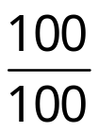
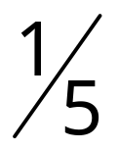
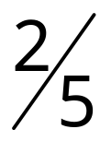
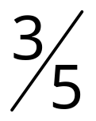
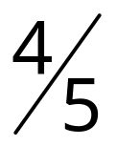
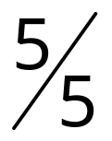
0
1
5%
15%
25%
35%
45%
55%
65%
75%
85%
95%
0.05
0.15
0.25
0.35
0.45
0.55
0.65
0.75
0.85
0.95
0
1
0.1
0.2
0.3
0.4
0.5
0.6
0.7
0.8
0.9
0.10
0.20
0.30
0.40
0.50
0.60
0.70
0.80
0.90
10%
20%
30%
40%
50%
60%
70%
80%
90%
0
1

Slide 21














1

